Slide 1
Cholesterol-Heart Disease Relationship in the US
Adam Astor

Slide 2
Cholesterol-Heart Disease Relationship in the US
Do people who suffer from heart disease have higher cholesterol levels than people who do not?

Slide 3
Cholesterol-Heart Disease Relationship in the US
Heart disease is the leading cause of death for men and women in the United States.
Chances are high that you or a loved one will suffer from heart disease.
Could lowering cholesterol levels protect from getting heart disease?

Slide 4
Cholesterol-Heart Disease Relationship in the US
Data Analyzed
303 patients observed in study
Data refers to cholesterol levels and whether or not the patient suffered from heart disease
Raw data available here

Slide 5
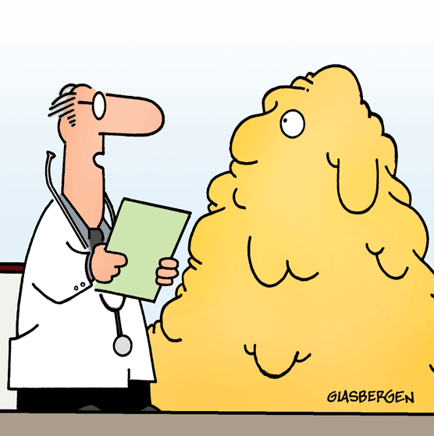
Cholesterol-Heart Disease Relationship in the US
Is cholesterol as bad as we think it is?

Slide 6
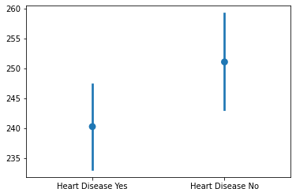
Cholesterol-Heart Disease Relationship in the US
Difference between heart disease and non-heart disease patients’ cholesterol levels
Average cholesterol level is ~12 mg/dl lower in patients with heart disease
“Healthy” cholesterol levels are <200 mg/dl

Slide 7

Cholesterol-Heart Disease Relationship in the US
It’s not going to kill you…
High cholesterol alone won’t signify heart disease
Recommend exercise, eating fiber, and maintaining a healthy weight
Goal of lowering your cholesterol is still a good idea

Slide 8
Questions?

Slide 9
Thank You

